Slide 1
REACT JS

Slide 2
Agenda
Introduction: What is React JS?
How React JS works?
Applications and examples
Traditional Web development vs React JS
Conclusion

Slide 3

What is React js?
React JS is JavaScript library for building user interfaces. It was developed at Facebook in 2011. React is one of the most popular to build user interfaces, you can use it not only to develop web pages, but also mobile applications in Android and IOS.

Slide 4
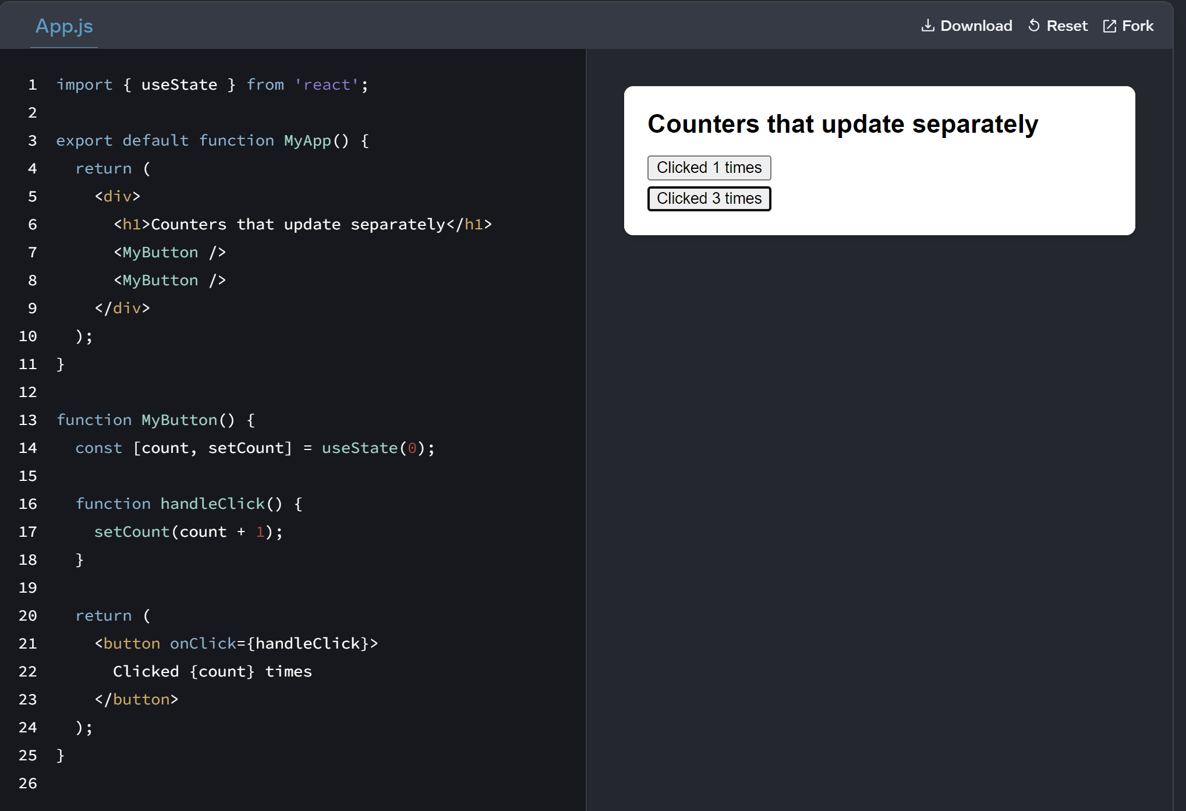
How React JS works?
React JS establishes that by unifying the three traditional pillars in web development—HTML, CSS, and JavaScript—we can achieve another level of standardization, code reuse, and significant improvements in the user experience. Therefore, React JS works with components, those are a mix of HTML, CSS and JavaScript. These components could be our nav bar, profile section, among others. The main idea of work with components is make them independents between them, versatile and reuse

Slide 5
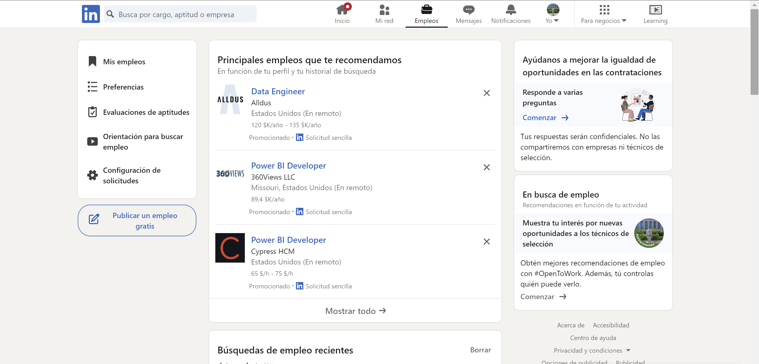
Applications and examples

Slide 6
Traditional Web development vs React js
Traditional Web Development:
Frontend Technologies:
HTML, CSS, JavaScript (Vanilla JS).
Emphasis on direct manipulation of the DOM.
Server-Side Rendering (SSR):
Pages generated on the server and sent to the browser already rendered.
Full Page Reload:
Changes in the application typically require a full page reload.
State Handling:
Reliance on techniques like forms and cookies to handle state.
React.js:
Component-Based Architecture:
Development based on reusable components that manage their own state.
Virtual DOM:
Uses a Virtual DOM to optimize updates to the actual DOM, improving performance.
Single Page Applications (SPA):
Loads a single page and dynamically updates content based on user interactions.
Centralized State Management:
Utilizes a centralized state management system (e.g., Redux) for more efficient state handling.

Slide 7
Conclusion ​

